Slide 1



Developing an Artificial Intelligence (AI) - Powered System for Enhancing Transparency and Accountability in Public Procurement and Project Monitoring in Tanzania
Presenter: Dr. Florence Upendo Rashidi
Presented on 30 May 2024,
Duration 7mn + 3mn
During the ”Innovate for Impact” workshop
In collaboration with the ITU AIforGood Scholars

Slide 2
Problem to be addressed
Public procurement and project monitoring in Tanzania face significant challenges due to a lack of transparency and accountability. The current processes are often plagued by corruption, fraud, and inefficiencies, which undermine the effective allocation of resources and project outcomes. This problem is particularly severe in developing countries, where oversight mechanisms and data management systems are less mature.
Key issues include:
Lack of Transparency
Resource Constraints
Reactive Measures
Complexity of Corrupt Practices
Notes:
Lack of Transparency: The procurement processes lack sufficient transparency, making it difficult to monitor and ensure compliance with regulations and standards.
Resource Constraints: There is a lack of sufficient resources, including advanced technological tools and skilled personnel, to effectively monitor and manage procurement and project implementation.
Reactive Measures: The existing legal and audit mechanisms are primarily reactive, addressing corruption and fraud after they occur rather than preventing them.
Complexity of Corrupt Practices: The scale and complexity of corrupt practices in procurement processes make it difficult for traditional methods to detect and address these issues efficiently.

Slide 3
Problem to be addressed
Case Study 1: Corruption in Building & Road Construction Projects
Description: The AI system identified irregularities in the procurement process for road construction projects, highlighting discrepancies between tender documents and actual project implementation.
Case Study 2: Fraud Detection in Health Sector Procurement
Description: The AI-powered tool uncovered fraudulent activities in procuring medical supplies, preventing significant financial losses, and ensuring timely delivery of critical health resources.
Case Study 3: Mismanagement in Educational Infrastructure Projects
Description: Analysis of project monitoring data revealed mismanagement and potential corruption in the construction of school facilities, leading to corrective actions and improved oversight.

Slide 4
Problem to be addressed
SDG 9: Industry, Innovation, and Infrastructure
Relevance: Ensures integrity in the procurement process, which is crucial for developing quality, reliable, and sustainable infrastructure.
SDG 11: Sustainable Cities and Communities
Relevance: Enhances the tendering process, contributing to the development of sustainable cities through accountable and transparent governance, leading to the efficient creation of public services and infrastructure.
SDG 16: Peace, Justice, and Strong Institutions
Relevance: Combats corruption and enhances transparency, significantly building effective, accountable, and inclusive institutions at all levels.

Slide 5
Background of Existing body of work/Literature survey/gaps
Existing Body of Work
Traditional Anti-Corruption Mechanisms:
Legal frameworks and audit processes have been the primary tools in combating corruption.
Manual review and oversight by agencies such as the Prevention and Combating of Corruption Bureau (PCCB).
Public awareness campaigns and educational programs to highlight the consequences of corruption.
AI and Machine Learning in Anti-Corruption:
Recent studies highlight the potential of AI to enhance transparency and efficiency.
AI models, especially Large Language Models (LLMs), are used to analyze vast datasets for anomaly detection, predictive analysis, and other downstream tasks.
Notes:
Literature Survey
Aarvik, P. (2019):
Discusses the potential of AI as a promising tool in development settings to combat corruption.
Emphasizes the role of AI in providing proactive solutions and real-time monitoring.
Adobor, H. & Yawson, R. (2022):
Explores the application of AI in combating public corruption in emerging economies.
Proposes a conceptual framework for integrating AI into anti-corruption strategies.
Gaps in Current Solutions
Limited Data Integration:
Existing systems struggle to integrate and analyze fragmented data from multiple sources.
Reactive Approach:
Traditional mechanisms are more reactive, addressing issues post-occurrence rather than preventing them.
Technical Expertise:
Lack of skilled personnel to develop, deploy, and maintain advanced AI systems.
Scalability Issues:
Many solutions are not scalable, limiting their effectiveness in larger or more complex procurement processes.
Bias in AI Models:
Potential biases in AI models due to inadequate training data or improper fine-tuning.
Identified Needs
Proactive and Preventive Systems:
Development of AI systems that can proactively identify and prevent corrupt practices before they occur.
Comprehensive Data Analysis:
Enhanced capabilities to analyze large volumes of data from diverse sources in real time.
Ongoing Training and Adaptation:
Continuous training and updating of AI models to adapt to evolving corruption tactics and regulatory changes.

Slide 6
Our Solution: AI-Powered System Overview
Objective: Enhance transparency and accountability in public procurement and project monitoring in Tanzania using advanced AI and machine learning techniques.
Components:
Data Collection: Comprehensive datasets from PCCB, district councils, courts, tax authorities, and procurement regulatory bodies, including tender documents, evaluation reports, corruption cases, and relevant laws and regulations.
NLP and LLM Techniques: Use NLP techniques for data preprocessing, analyzing, and understanding the procurement domain.

Slide 7
Our Solution: AI-Powered System Overview
Core Functions:
Text Generation: Assist investigators by generating relevant text using generative AI.
Text Classification: Classify documents such as corruption/no corruption.
Anomaly Detection: Identify irregularities and anomalies in procurement data.
Multimodal Analysis: Integrate various data types for comprehensive insights.
Model Training and Fine-Tuning:
Unsupervised Pre-Training: Initial model training on a large dataset to gain a general understanding.
Supervised Fine-Tuning: Specific task training such as sentiment analysis, named entity recognition, text classification, and text generation for detailed analysis.
Notes:
Key Benefits and Implementation
Real-Time Monitoring:
Continuous monitoring of procurement processes and project execution.
Real-time analytics and reporting to ensure compliance and detect irregularities.
Proactive Corruption Detection:
AI system to predict and detect patterns indicative of corruption.
Corruption probability percentages provided through natural language classification tasks.
Improved Resource Allocation:
Automated document analysis to streamline investigative efforts.
Efficient allocation of resources for higher impact and timely interventions.
Stakeholder Empowerment:
Provides detailed reports and insights to PCCB and other stakeholders like judiciary and public procurement regulator authority (PPRA).
Supports informed decision-making and proactive intervention against corrupt activities.
Challenges and Considerations:
Data Quality and Volume: High-quality, large-volume data is essential for effective AI performance.
Continuous Updates: Regular training and updates to the AI system are necessary to adapt to changing regulations and evolving corruption tactics.
Technical Expertise: Requirement for ongoing technical expertise to manage and update AI systems.
Scalability:
Designed to be scalable, allowing for broader adoption across other nations facing similar challenges in public procurement.

Slide 8
Our Solution: AI-Powered System Overview
Key Benefits and Implementation
Real-Time Monitoring:
Continuous monitoring of procurement processes and project execution.
Real-time analytics and reporting to ensure compliance and detect irregularities.
Proactive Corruption Detection:
AI system to predict and detect patterns indicative of corruption.
Corruption probability percentages provided through natural language classification tasks.
Improved Resource Allocation:
Automated document analysis to streamline investigative efforts.
Efficient allocation of resources for higher impact and timely interventions.
Stakeholder Empowerment:
Provides detailed reports and insights to PCCB and stakeholders like the judiciary and public procurement regulator authority (PPRA).
Supports informed decision-making and proactive intervention against corrupt activities.

Slide 9
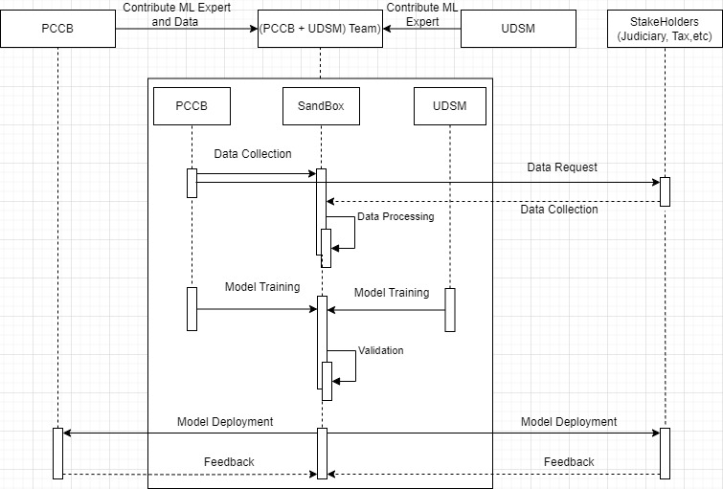
Our Solution: Sequence Diagram

Slide 10
Future Works: Training in Multimodal and Integration
Objective: Expand the AI system’s capabilities by training it on a broader range of domains and with different models (language, vision, and text) to improve accuracy and adaptability.
Approach:
Data Collection: Gather diverse datasets from multiple domains such as healthcare, education, infrastructure, and governance.
Unsupervised Learning: Use unsupervised pre-training techniques to develop a foundational model that understands various domains.
Supervised Fine-Tuning: Fine-tune the model for specific tasks in each domain, such as anomaly detection in healthcare procurement or compliance checks in education projects.

Slide 11
Future Works: Contributions to ITU, Impact to SDGs
ITU Collaboration:
Aligning with ITU’s AI for Good initiative to leverage AI for social impact.
Contributions to standard development related to AI in corruption prevention.
Impact on UN SDGs:
SDG 9 (Industry, Innovation, and Infrastructure): Ensuring integrity in the procurement process, supporting resilient infrastructure development.
SDG 11 (Sustainable Cities and Communities): Enhancing governance and transparency, contributing to sustainable urban development.
SDG 16 (Peace, Justice, and Strong Institutions): Building effective, accountable, and inclusive institutions by combating corruption.

Slide 12
Future Works: Planned Workshops
Training Sessions:
Conduct workshops for PCCB staff and other stakeholders on using the AI system.
Hands-on training for data collection, system usage, and interpreting AI-generated reports.
Awareness Campaigns:
Organize seminars to raise awareness about the importance of transparency and the role of AI in combating corruption.
Collaboration with universities and civil society organizations for broader outreach.

Slide 13
Future Works: Call for Collaborations
Research and Development:
Inviting academic and research institutions to collaborate on enhancing AI models and methodologies.
Opportunities for joint research projects and publications.
Public and Private Sector Partnerships:
Seeking partnerships with technology companies for technical support and system enhancements.
Collaboration with government agencies and international organizations to expand the project’s scope and impact.
Funding and Resources:
Encouraging donor agencies and international bodies to provide funding and resources for project scaling.
Proposals for grants and sponsorship to support ongoing development and deployment efforts.

